Slide 1
PEL131 CA-4 PRESENTATION Slide no. 1 WHY THE LABOR LAWS IN INDIA ARE INADEQUATE
SUBMITTED TO: SUBMITTED BY:
DR.NITIN MALHOTRA G.RAVI KANTH
PEL131- SECTION k1651 11616140-B43

Slide 2
Slide no. 2 WHAT IS LABOR LAW’S
According to S.E Thomas, “Labour connotes all human effects body or mind which are undertaken in the Expectation of Reward.”
This means “A Law relating to the rights and responsibilities of workers”.
It primarily concerns the rights and responsibilities of unionized employees..
A Labor Law is Also Called as Employment Law/Industrial Law…
Introduction:
Labor laws first arrived as standards in industrial Revolution.
Labor laws have two Categories:
Collective
Individual
Collective labour law relates to the tripartite relationship between employee, employer and consolidation/Government.
Individual Law is About Employees’ Workplace Rights

Slide 3
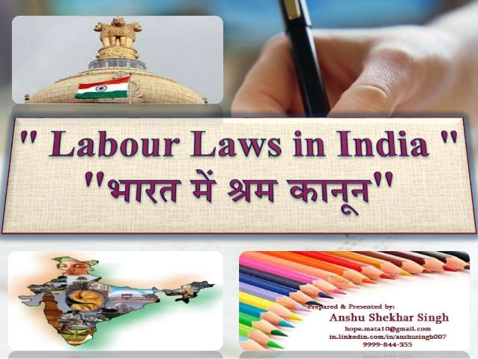
Slide no. 3 The final Goal of Labour laws is to reduce the differences between the employer and Employee which leads in Industrial Growth and Growth of Nation. some OF Labor Laws
The Maternity Benefit.
Industrial labour/Relation.
Other Laws and Act’s.
Child labour.
Maternity Benefit.
The Maternity Benefit Act, Aims to regulate of employment of women employees in certain establishments for certain periods before and after child birth and provides for maternity and certain other benefits.
The Company gives 12 weeks Leave before and after delivery.

Slide 4
Slide no.-4 WHAT IS INDUSTRIAL RELATION..??
IR is a Relationship Between management and Employees or among employees and their organizations.
To promote and develop labor management relation.
To encourage and develop trade unions in order to improve the workers strength.
To improve working and living Conditions.
To enlarge the opportunities of promotion and training.
Workers have the right to strike. If they are Facing any Problem, Form Organizations
TYPES OF IR:
1. Payment/Minimum of wages Act-1936
2. Payment of Bonus Act-1965
3. Payment of Gratuity Act-1972

Slide 5
Slide no. 5
Payment Act:
State and Central Government’s Frames the wages According to Their skills and Worker’s Standard of Living.
Government Fixes the wages from the Context of Standard of Living and Costs of living in States for different Jobs.
Purpose: protect the workers from being paid low wages.
Employer Needs to Make sure the employee wages are sufficient for his Standard Living.
If Employer fails to pay Minimum wages, Government has Right to take him/her to Prison
Bonus Act:
The Minimum Bonus payable to Employee is 8.33% Based on His/her Salary.
The Maximum Bonus payable to Employee is 20%.
The Employee Who has Completed >9 Months, Those are Eligible For Bonus.
Gratuity Act:
The Following Rules are Announced By Each government as per Citizens Standard Living..
Gratuity Means, The Employee Who has Completed Mini. 5years, He/she will get Extra Bonus, That Bonus is Called Gratuity.
Total Amount=(Worked years)*(Monthly Salary)*((days worked in Month)/No. of Working days in Month).
Companies Will gives Retirement Benefit To Worker as per Government Order/Rules..

Slide 6
Slide no.-6
OTHER LAWS AND ACT/RULES:
Employment injury- Health-Pension.
Compensation Act 1923(ESI Act 1948).
Holidays, vacations-Emergency Leaves-Procrastination.
Equal Remuneration Act-1976
Companies has a right to Reduce the salary Due to late Arrivals, working cases…etc.,,
Working Hours-Unfair dismissals
Industrial Disputes-1947.
Migrant Labour
Records/Surveys
According to LFPR:- They estimated to be 52.5% at All India level of persons aged 15 years and above.
In rural Sector, the LFPR is estimated to be 54.7% whereas in the urban sector is 47.2%.
Female LFPR is Significantly lower as compared to LFPR among males.
All India level, Female LFPR is Estimated to be 25.8% as compared to 74.4% for males…
According to WPR:- They estimated 49.9% of persons aged 15 and above are Employed.
In rural Areas, WPR is Estimated to be 52.1% as compared to 44.6% in Urban Areas.
The Female WPR is estimated to be 23.8% in all India level as compared to male WPR of 71.4%.

Slide 7
SLIDE NO.-7 CHILD LABOUR Act1986
ILO is Focused Mainly on Elimination of Child Labour.
India is the one of the country where the age of Below 14 years children are Working in many hazardous work environment-Small scale industries..
The States like Bihar, Madhya Pradesh, Rajasthan,Uttar Pradesh and Jharkhand has 5.45 Millon children working in Small scale industires and hazardous work environment
Poverty, Lack of good Schools and Growth of informal economy are considered as the important causes of child labour in India .
ILO suggests poverty is the Greatest single cause behind child Labour.
The Right of Children to Free and Compulsory Education ACT of 2009:
The Central Government Has Taken Many Action’s and Launched Many Programme’s to Stop Child Labour, But Still…..
Non-Governmental Organisations:
Many NGO’s like Bachpan Bachao andolan, Care India, Child Rights and You, Global March against child Labour, Ride India etc…. Gruelling Issue’s on Those days.
Pratham is India’s largest Non-Government organisation with the mission “every child in School and Learning Well”. Founded in 1994.
According to the 1991 census, 11.28 million working children under the age of 14 years in India.
Over 85% of this child labour is in the Country’s rural areas, Working in Agricultural activities ,Forestry, rearing.. etc..,,,
According to the 2001 census, there were 12.6 million child workers between the ages of five and 14 in India. In 2011, this number fell to 4.35 million. The National Sample Survey Office's survey of 2009-10 put the number at 4.98 million.

Slide 8
Slide no.-8 HISTORY
Until 1919, ILO is Formed as part of the Treaty of Versailles After the WORLD WAR-1.
With the Establishment of ILO, All the Labour Laws Came into Act.
(ILO) was one of the first organisations to deal with labour issues.
ILO is United states Agency Dealing with Labour Problems.
The ILO Has 187 Country’s in member.
In 1969, the organization received the Nobel Peace Price.
SEWA- Anasuya Sarabhai, born in 1885, Ahmedabad. She has Smattering Women.
In 1916, Textile Labour Association(Mazdoor-Mahajan Sabha) lay the Foundation Mill by Mahatma Gandhi, on basis of this SEWA was Established.
The representing and recognized unions of Mill workers in Ahmedabad and Bombay were respectively the Mazdoor Mahajan Sabha and Rashthriya Mill Mazdoor Sabha.
As England was the first country to industrialize, it was also the first to face the often appalling consequences of industrial revolution in a less regulated economic framework
After Independence: According to Constitutional Rights-1950::;
Articles like 14-16,19(1)(C),23-24,38,41-43A This all are about Labour Concerns.

Slide 9
Slideno.-9
CONCLUSION
Maternity=Motherhood.
Consolidation=union.
Maternity Benefit=The Benefit which occurs at the time pregnancy/Delivery.
Procrastination=Postponing anything.
Conciliation=an action to stop who are in angry
Connotes=give a feeling of-give the Impression of.
Gruelling=Demanding.
Smattering=Introductory knowledge of something.

